Slide 1

Aircraft Traffic control
Udaybhan Rathore - 19328,
Pushpendra Dhakar - 19229

Slide 2
Project Propose:
The goal is to train a neural network to perform basic Air Traffic Control Tasks through reinforcement learning.
This approach could improve throughput of a sector, noise abatement and increase efficiency through continuous climb and descend profiles, which for example could save 1-2% of fuel.

Slide 3
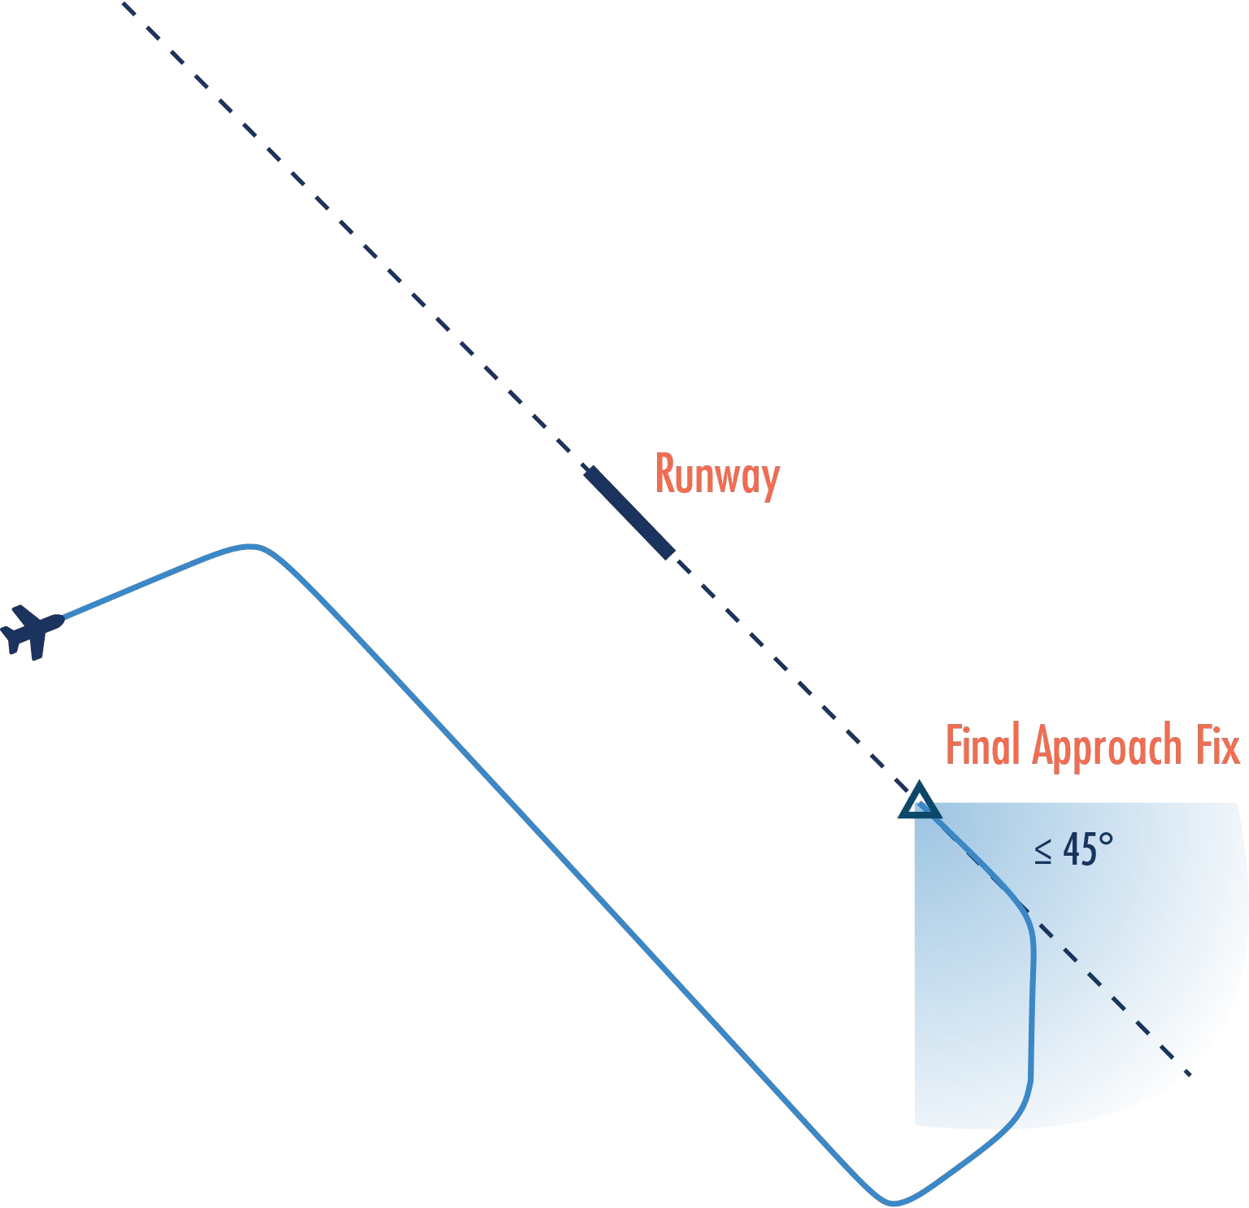
Task Description

Slide 4
Architecture
Open AI Gym
SARSA
MDP
ATC Gym
Interface
RL Algorithms
Custom Simulation

Slide 5
Custom Simulation
Simulation highly simplified aircraft performance model
Required Python Libraries Numpy, OpenGL, Shapely, and Pyglet
Basic Simulation Requirements:
Environment
Actions
Reward

Slide 6
Environment
Simulate a minimum vectoring altitude. This is a coarse approximation of the terrain.
Build at least one plane. Initially, a single aircraft could be simulated
Fix the final approach and this would return the target point to which the plane should move at or below a specific altitude
Build the basic aircraft model with fixed turn rate and descend/climb rate

Slide 7
Actions
Assign a heading to the airplane
Assign an altitude to the airplane

Slide 8
Reward
Bringing the aircraft to the Final Approach Fix (FAF) at the correct altitude and within the correct angle, wins the simulation
If every time step in which the airplane has not reached the FAF yet carries a small penalty
Descending the airplane below the Minimum Vectoring Altitude carries a heavy penalty
Not maintaining sufficient separation (e.g. 3nm and 1000ft) between two aircraft carries a heavy penalty
Having the aircraft leave the sector carries a heavy penalty
All heavy penalties could also be simulation end/game over state.

Slide 9
Implementation
The implementation consists of a simulation of the air traffic control task, with models for the airplane, minimum vectoring altitudes, airspace, and runway.
A second part is implemented for applying different reinforcement learning algorithms for optimizing the implemented simulation.
This approach provides a defined interface, based upon the OpenAI Gym implementation which can be plugged into different RL algorithms for evaluating the performance of different RL algorithms on this task.

Slide 10
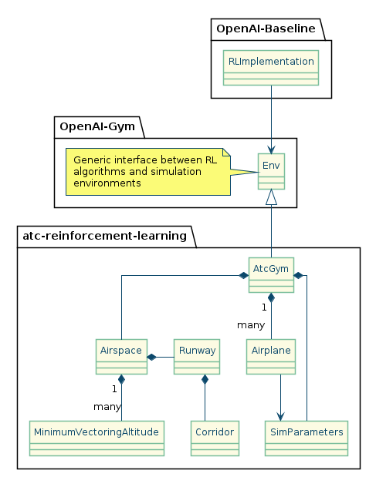
We are using this pipeline to build our model

Slide 11
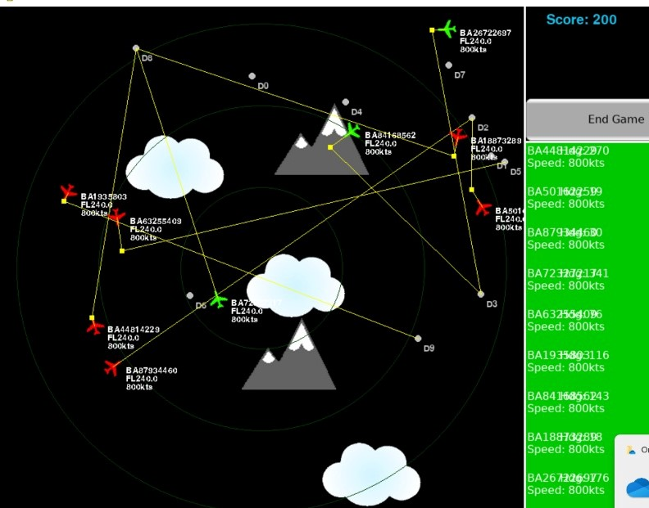
Simulation Result

